Slide 1
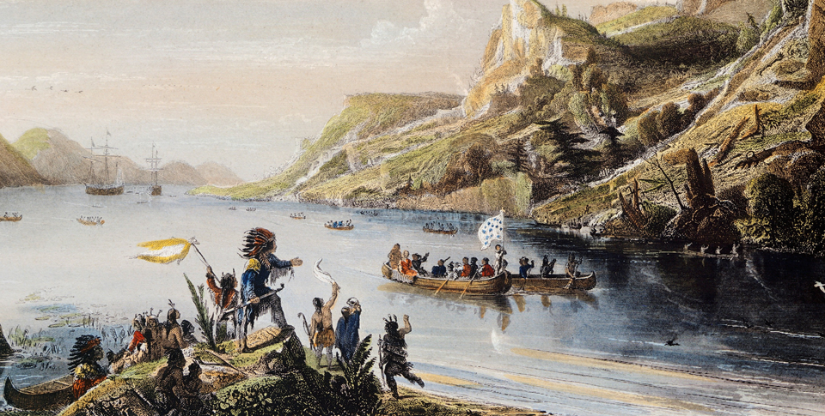
New Global Connections (1415-1796)
Lesson 4 European Colonies in North America

Slide 2
New Global Connections (1415-1796)
Topic 5 Lesson 4 European Colonies in North America
Key Terms
New France
Jacques Cartier
Samuel de Champlain
revenues,
John Cabot,
Pilgrims,
compact
French and Indian War.
Treaty of Paris

Slide 3
New Global Connections (1415-1796)
Topic 5 Lesson 4 European Colonies in North America
Learning Objectives
Explain why the colony of New France grew slowly.
Analyze the establishment and growth of the English colonies.
Understand why Europeans competed for power in North America and how their struggle affected Native Americans.

Slide 4
New France
French Exploration Begins
1534 Jaques Cartier explores Eastern Canada, discovers St. Lawrence River, uses the river to go inland
He will claim most of Canada for France. French explorers and fur traders will move inland with Native American help in exchange for support against other groups
New France Grows Slowly
First permanent French settlement was built in 1608. the colony of Quebec was established by Samuel de Champlain.
Attracting French peasants was hard, long winters combined with more profitable enterprises like fur trapping, trading, and fishing made less people come

Slide 5
New France
Royal Power and Economic Growth
King Louis XIV wants to increase his revenue so he will send officials to help out in New France in the 1600’s
He will send soldiers and women but not Protestants because he is Catholic
By 1700’s New France will have colonies from Quebec to Louisiana but the population of those colonies will be quite small compared to the English colonies

Slide 6
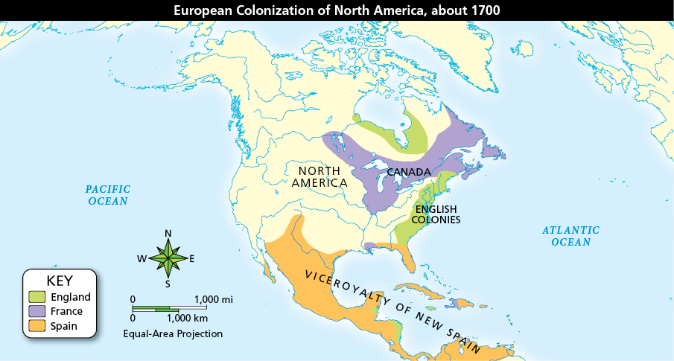
New France
England, France, and Spain controlled large parts of North America. Their colonies differed from each other in a number of ways.

Slide 7
New France
French explorer Jacques Cartier found that the St. Lawrence River was a gateway into a vast territory of rich forests, with an abundance of fish and animals that could provide wealth from trade.

Slide 8
The 13 English Colonies
Jamestown
English first permanent colony in North America. Most settlers will die of starvation or disease. The rest survive with help from Native Americans
Plymouth
1620 English Protestants settled in Plymouth, Massachusetts.
They sought religious freedom, not commercial profit
Before coming ashore all the males will sign the Mayflower Compact, agreeing to a way of governing themselves
Many will die until the get help from the Native Americans and later on more Protestants will arrive to help
Expansion and Prosperity
Colonies were set up for commercial ventures, havens for persecuted religious groups, or gifts from the King of England
Colonies used their environment to develop their economy
Colonies will use Africans as their labor source

Slide 9
The 13 English Colonies
Limited Self-Government
Just like in the Spanish and French colonies English kings set up royal governors to help govern the colonies
Unlike those other places however English colonist had a representative assembly that advised the governor and decided local issues
This idea stemmed from the English experience with govt, as the English gain certain legal and political rights
Colonists who protest against British policies later on consider themselves freeborn Englishmen defending their rights

Slide 10
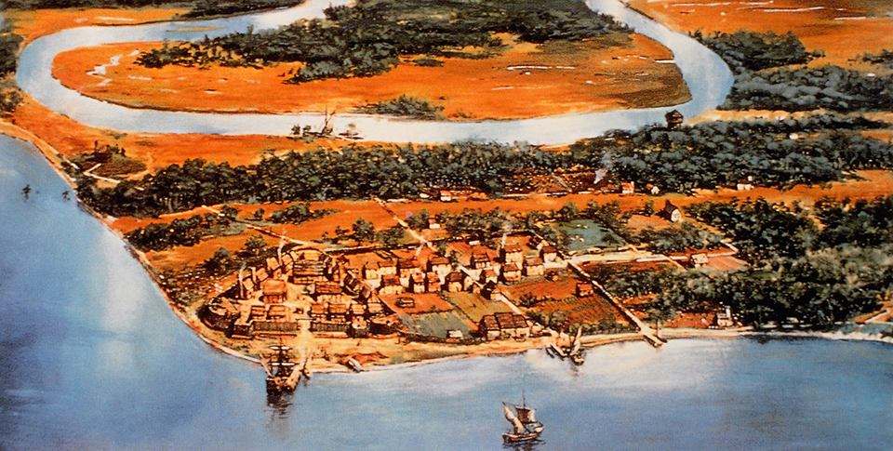
The 13 English Colonies
Jamestown was located in a prime location. Situated near the Atlantic, it had a port for ships to dock. The James River provided fresh water, teeming fish, and a route to the interior.

Slide 11
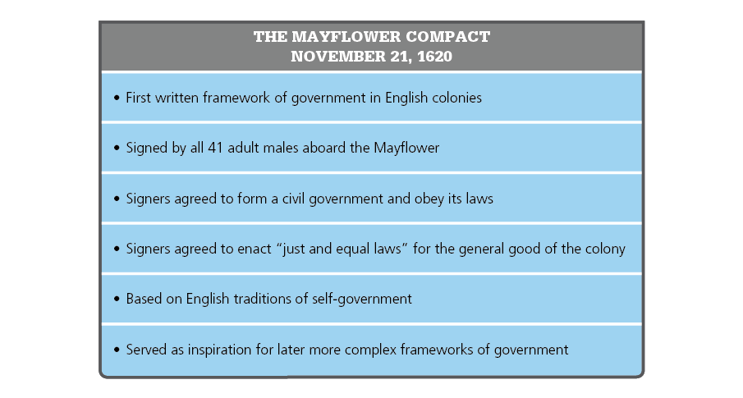
The 13 English Colonies
In the Mayflower Compact the Pilgrims agreed to form a government and obey its laws. The idea of self-government would later become a founding principle of the United States.

Slide 12
A Power Struggle Begins
A Race for Colonies
By the late 1600’s: the French claim Canada and the central part of the US, Spain claims Texas and Florida, English and Dutch maintain colonies on the East Coast of the US
French and English also fight to acquire the profitable sugar producing colonies of the Caribbean
Britain and France in a Global Struggle
1754 fighting breaks out between the British and French
This is called the French and Indian war and link to the Seven Years War in Europe and conflicts in India
The English have more colonists in North America than the French do
1759 the British capture Quebec and in 1763 control Canada
1763 Treaty of Paris The British get all of Canada and all lands east of the Mississippi, France gets its Caribbean islands back

Slide 13
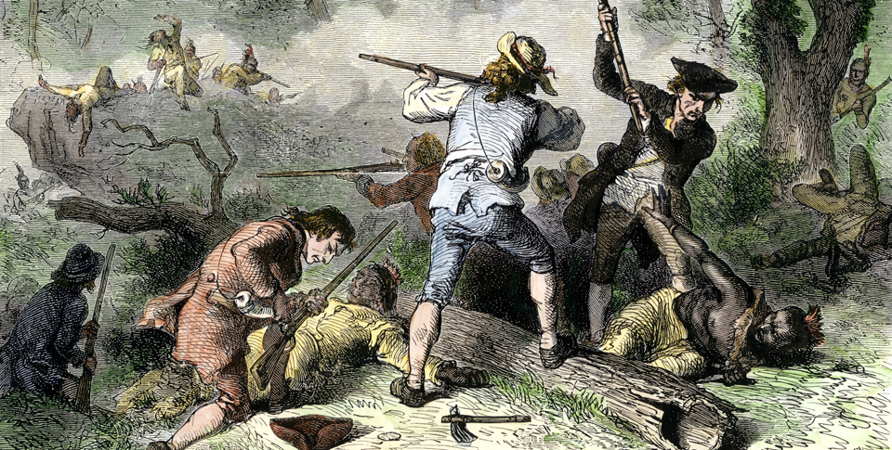
A Power Struggle Begins
English colonists battle against Native Americans. As Europeans competed for control of North America, Native Americans entered the conflict and fought to defend their lands.

Slide 14
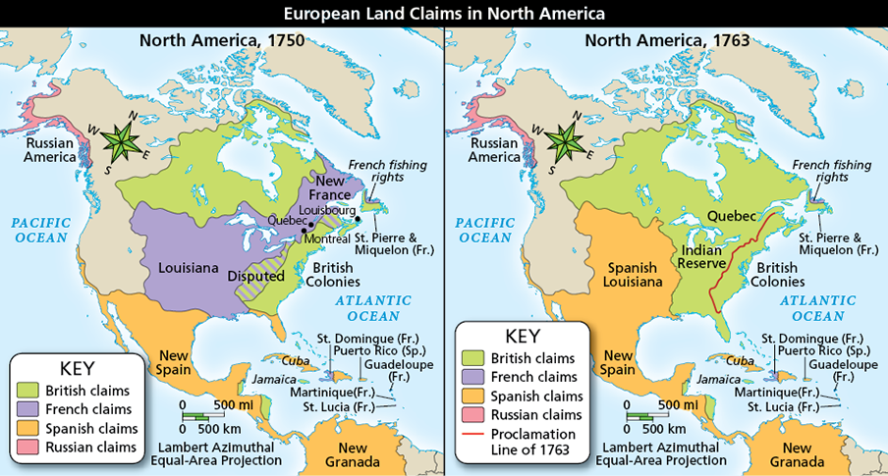
A Power Struggle Begins
Analyze Maps Which nation was Britain’s main rival in 1750? How was that rivalry different in 1763?

Slide 15
Quiz: New France
Which of the following was a problem that limited the growth of New France?
A. Louis XIV did not support the growth of New France.
B. Long, harsh Canadian winters made farming difficult.
C. Native Americans taught the French how to harvest cod for export.
D. French explorers were unable to find inland water routes in North America.

Slide 16
Quiz: The 13 English Colonies
Which of the following is TRUE about England’s American colonies?
A. They were free from English royal authority.
B. They abolished slavery and guaranteed rights.
C. They had a poor economy with few resources.
D. They had some power to govern themselves.

Slide 17
Quiz: A Power Struggle Begins
The most significant result of the 1763 Treaty of Paris was that
A. Britain became the dominant power in North America.
B. France gained control of valuable Caribbean islands.
C. Britain ceded Canada to France.
D. The French and Native Americans had a strong alliance.

